Slide 1
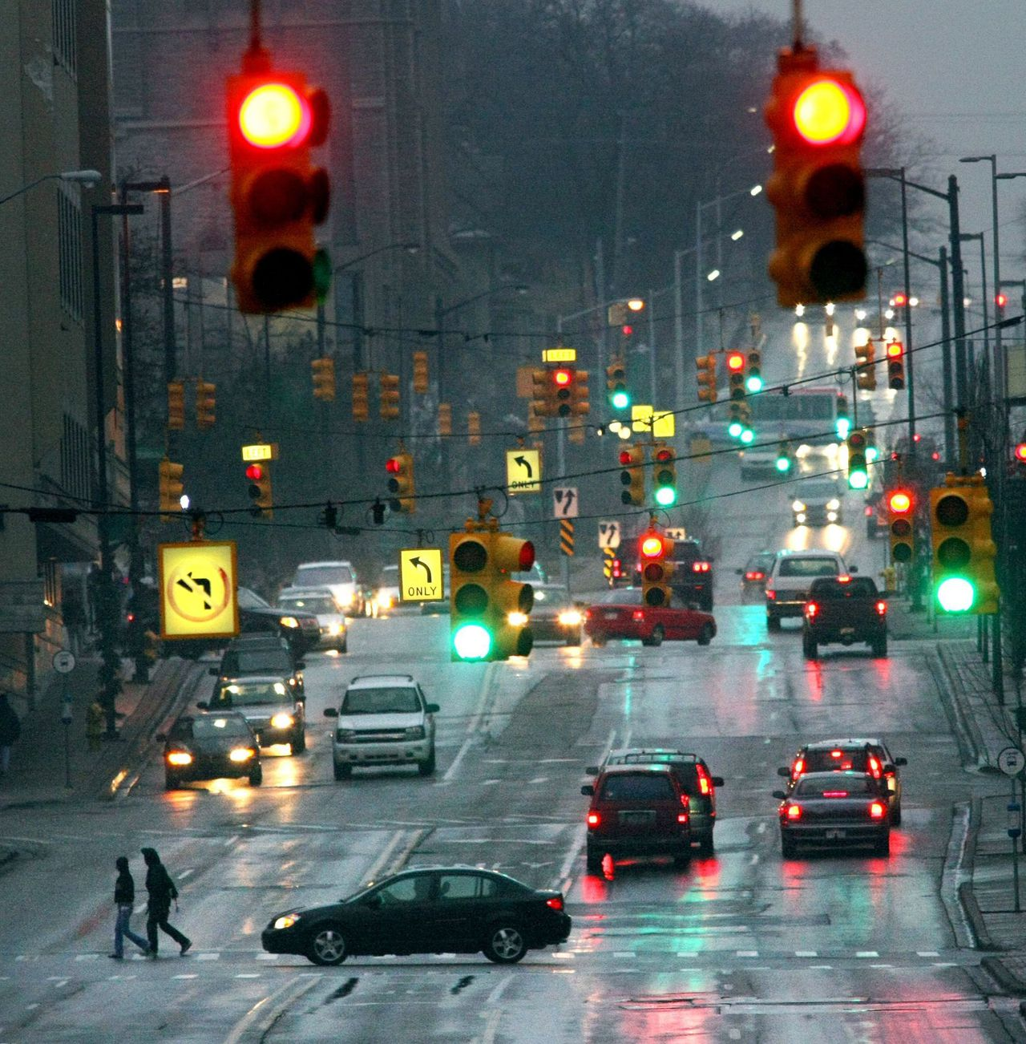

ABALEET Final Presentation
Beki Márta (2073056)
Luka Bijma
Alexey Zobnin
Basheva Elitsa
Elisé Minani
Aryan Shinde
Tim van Kollenburg

Slide 2
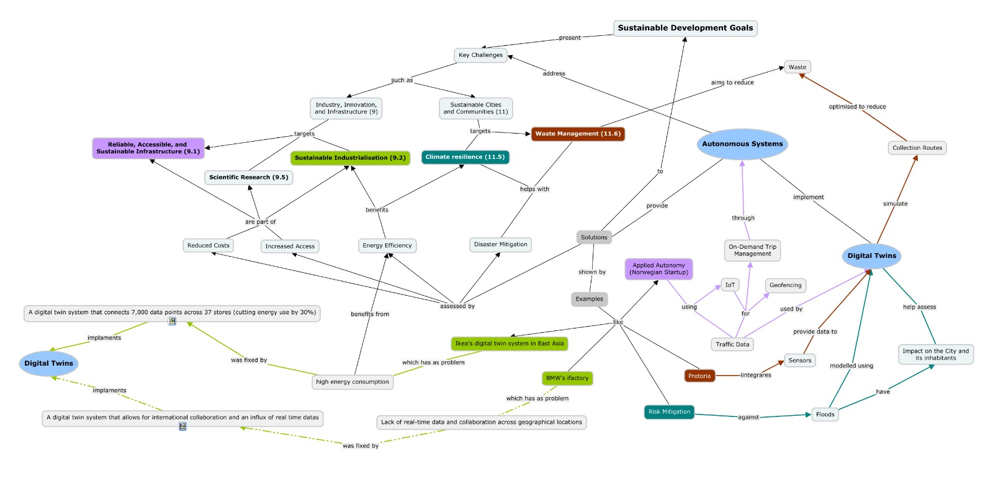
Initial concept
Notes:
Problems: The problems we chose were based on the SDG’s 9/11 and our aim was to present our research of the innerworkings of Autonomous systems and Digital twin together with the SDG’s
Too stuffy
Arrows pointing everywhere
Some places miss arrows
Too long nodes
Digital Twins mentioned twice
No clear starting point

Slide 3
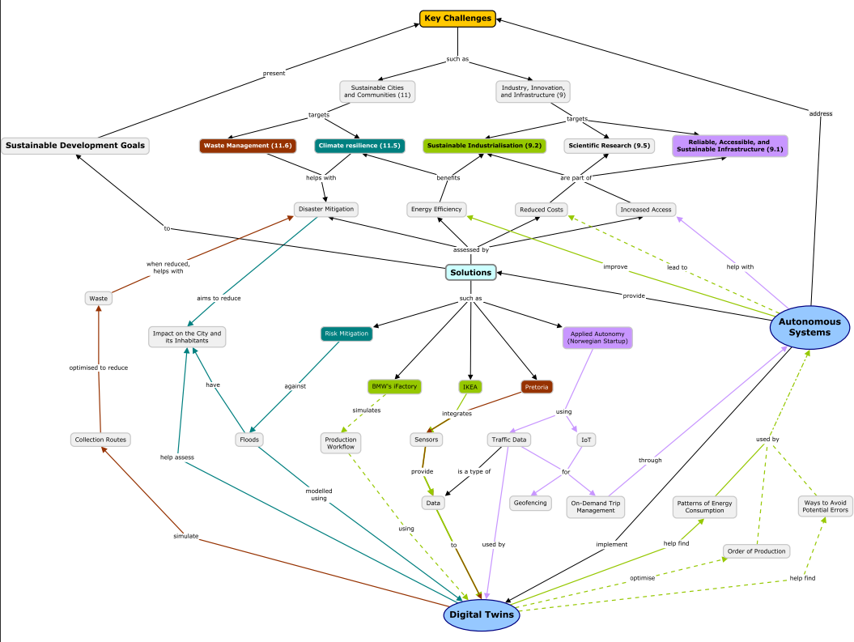
Initial concept
Clearer structure
Less long nodes
Better visual
Arrows
Colouring
Works towards technical solution

Slide 4
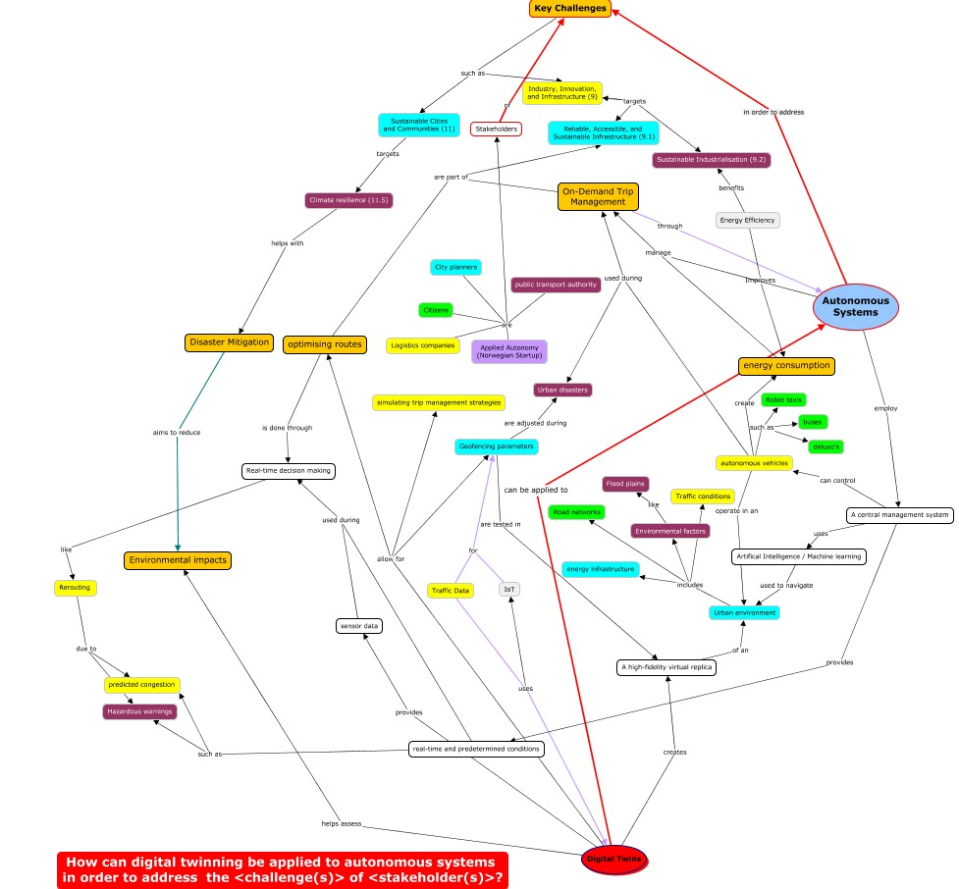
Technical Solution

